Slide 1
Step by step guide to DMF automation system

Slide 2
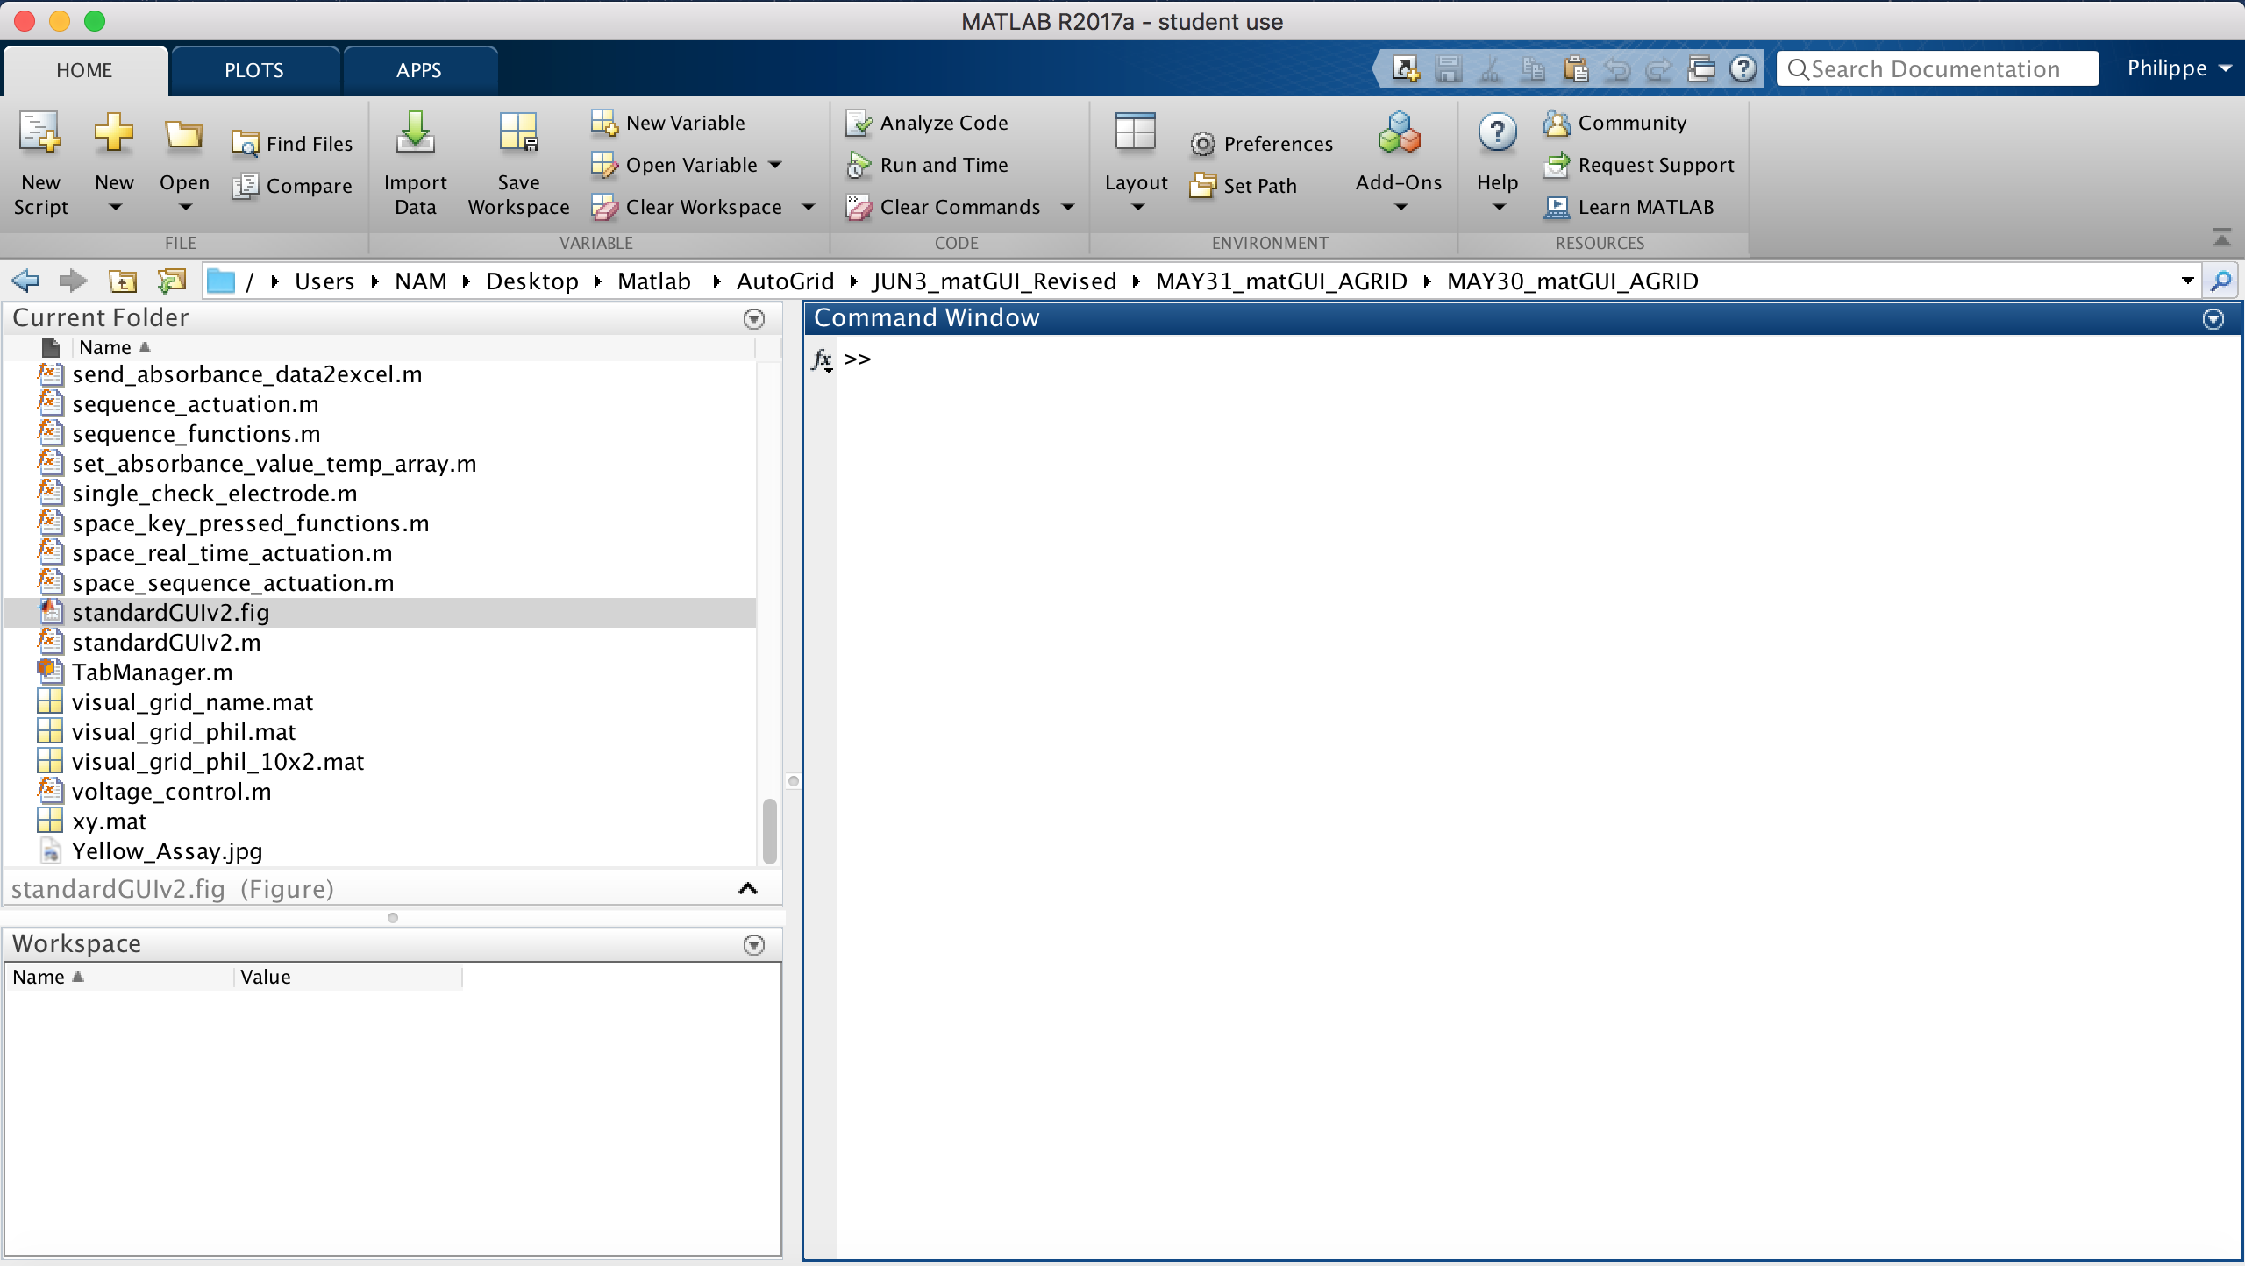
This is the main window of Matlab.
To access to the automation GUI, first navigate to the file and open it in Matlab. (the location of the file depends on where you downloaded the code to)
Once opened, double click on ’ standardGUIv2.m ’ and a window will appear.

Slide 3
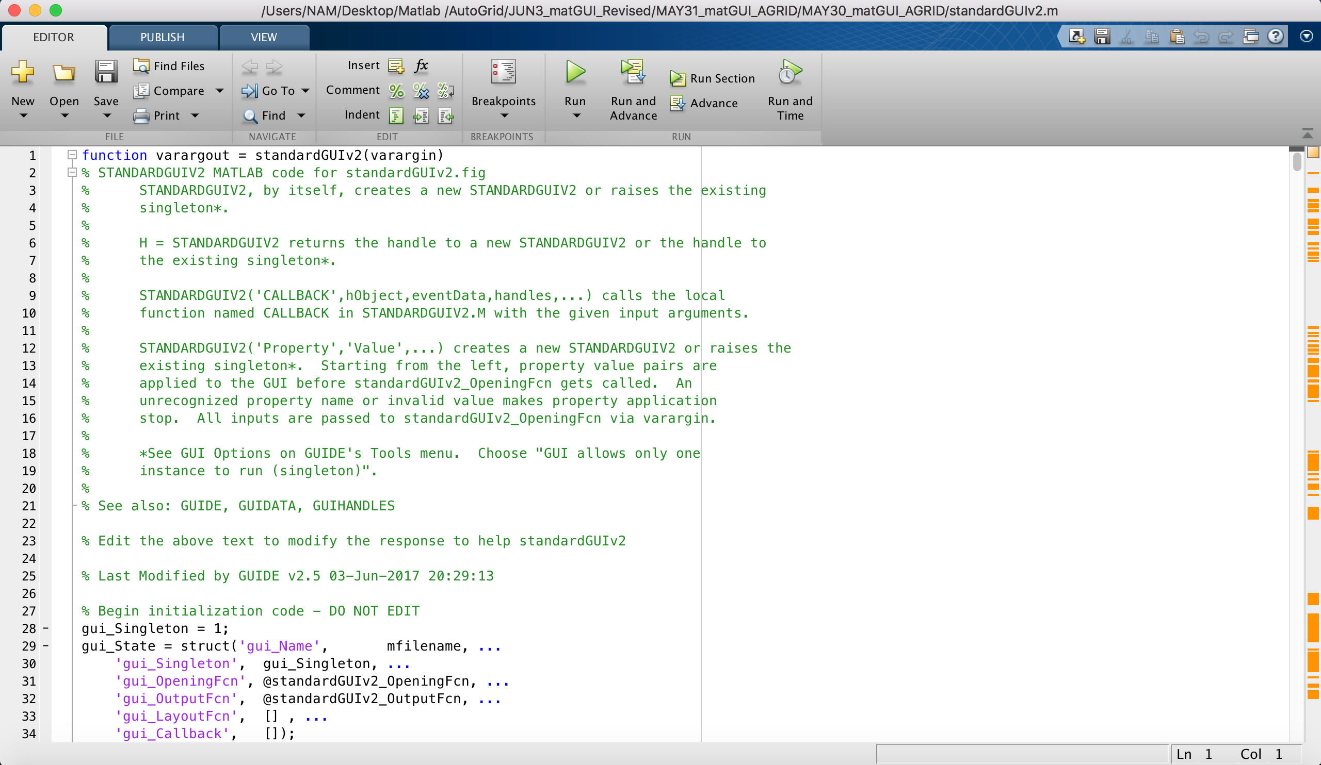
This window should appear after you have double clicked on ’ standardGUIv2.m ’. It is the body of the main code.
- To open the program itself, click on the ‘ Run ‘ button.

Slide 4
Layout of the GUI
General Setup
Electrode functions
Function Generator and time setup
Visual grid setup
Electrode button grid
Live feed Camera
Sequence control
Feedback Control

Slide 5
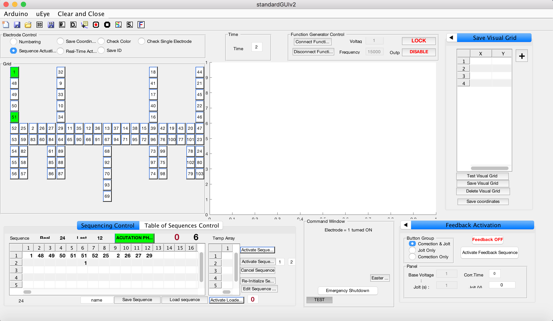
1
3
4
2
5
6
7
8

Slide 6
Creating a DMF Grid :
Click on the ‘ New grid ’ icon in the ‘General Setup ’ area.
Insert number of rows and columns.
Click on the ‘ numbering ‘ radio button in the ’ electrode functions ’area .
Insert the electrode number.
Once everything is numbered, click on ‘ Save grid ‘ icon in the ‘General Setup ’ area and then name the grid.

Slide 8
Connection Setup :
Click on the ‘ Arduino ‘ button in the ‘ General setup ’ area and select ‘ Connect ‘.
Input the COM number the Arduino is connected to.
Click on the uEye button which is next to the Arduino one and select ‘ Connect ’.
Click on the ‘ Connect Function Generator ‘ in the ‘ Function Generator and time setup ’ area.

Slide 9
Sequence Setup :
Click on ‘ Sequence Actuation ’ radio button.
Make your sequence by clicking on the electrode button (multiple if needed) and press on space to save that ’ one step ’.
Repeat until you finished making your sequence.
Input parameters of voltage, time and frequency in the ‘ Function Generator and time setup ’ area.
Click on ‘ Activate Sequence ‘ button when you are ready.

